Slide 1
Single lead mobile ECG machine
Major Project Presentation
Group Members
Sudipta Sen
Tanima Ghosh
Raju Adhikary
Goutam Ambali
Ruma Mandi
Guide: Souvik Bag
Ranaghat Government Polytechnic
Department of Electrical Engineering

Slide 2
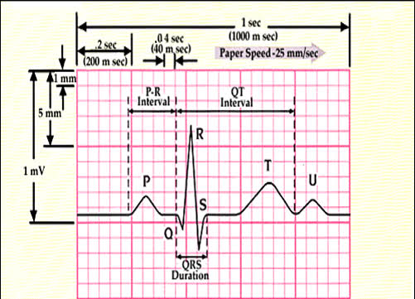
Introduction
Introduction to ECG machines.
Importance of ECG in medical diagnostics.
How ECG works
Analyse the graph for regular or abnormal patterns
PQRST Waves
P – Electrical signal generated by the Sinoatrial (SA) node
Q – Initial phase of ventricular depolarization
R – Main phase of ventricular depolarization
S – Final phase of ventricular depolarization
T – Ventricular repolarization

Slide 3
Problem Statement
High cost of multi-lead ECG machines.
Complexity in usage and maintenance
Trained operator needed.
Limited access in rural or remote areas.
Hospital or clinical facilities far away
Need of a simpler, cost-effective solution.
Patient can use themselves without much training.
Everyone can afford.

Slide 4
Proposed Solution
Single-lead ECG machine.
Key features: affordability, simplicity, portability.
Ease Of Use...
How the design addresses the problems.
Less electrode → less cost , more simplicity
Less components → lower in size
Cross platform availability and data processing.
Available in wide range of platform mobile, tablet, laptop, desktop and etc.
Appropriate data processing to adapt different screen sizes.

Slide 5
System Design
Key Components Used
Electrode
BioInstrumentation Amplifier (AD8232)
OpAmp (Three OpAmp Analogy)
High precision resistors i.e metal film resistor (1% tolerance)
Filter
High-pass Filter
Low-pass Filter
Band-pass Filter
Analog Signal Display Unit
Signal flow from electrode to display

Slide 6
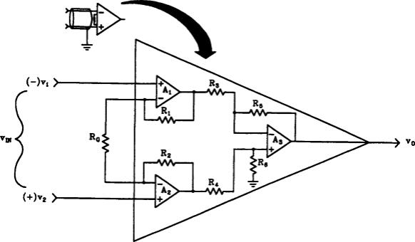
Instrumentation Amplifier
Electrocardiogram (ECG or EKG), Electroencephalogram (EEG), Electromyogram (EMG) , Electrooculogram (EOG) 👀 , Action Potential Amplitude (AAP)

Slide 7
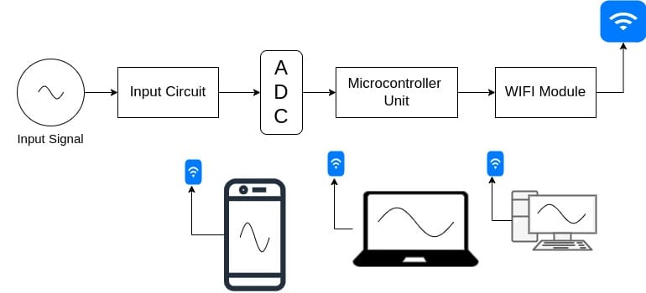
Custom-Built DSO
Requirement of DSO in testing and visualizing ECG signals
Why A custom one (Reduce cost , tailored for the project)
Modifications Made
WIFI Enabled Technology
Limitations

Slide 8
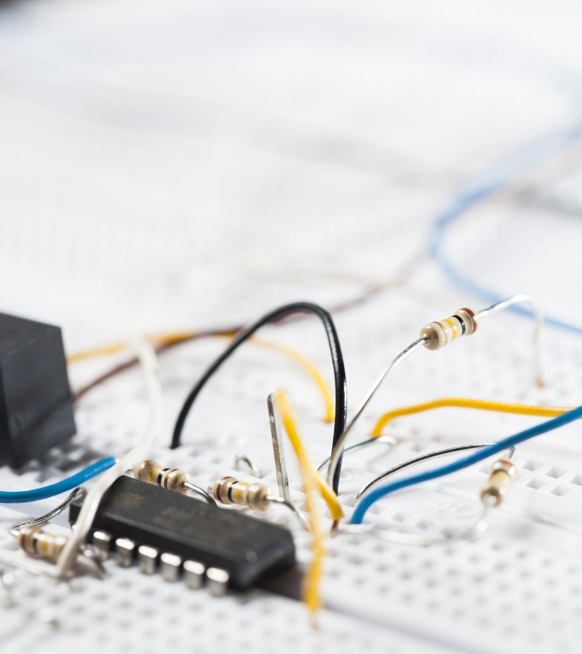
Implementation
Transformation from idea to prototype.
Electrodes made by bending copper wire in spiral shape.
BioInstrumentation Amplifier → AD8232(Analog Devices)
ADC + MCU + WIFI module → ESP8266
Battery → 1200mah , 3.7v Lithium-ion battery
Charging solution → TP4056 power management IC
Modifications made during implementation.
Eliminate ground electrode to make the design simpler

Slide 9
Demonstration

Slide 10
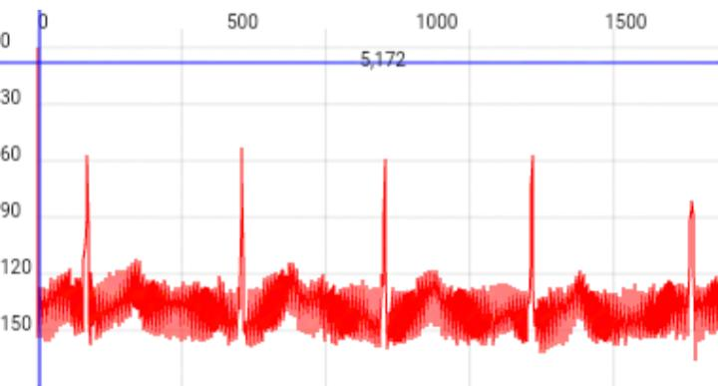
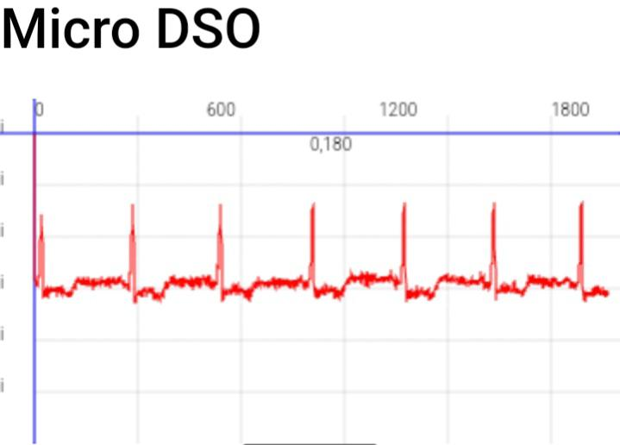
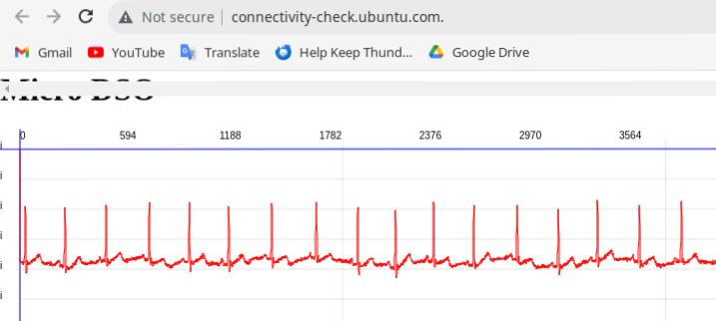
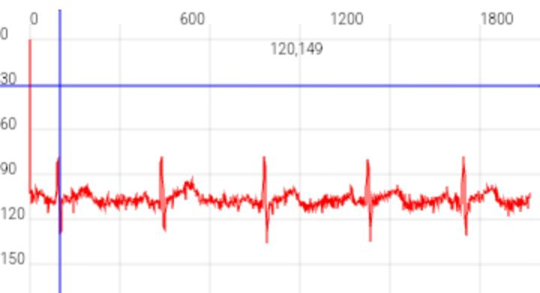
Result
Sample 1
Sample 2
Sample 3
Sample 4

Slide 11
Challenges and Solution
External Interference and noise.
AC plug makes noise → don’t allow using the device while AC power plugged-in
EMG noise → stay calm and avoid unnecessary muscle movement during ECG recording.
Electrode placement
Find best places for electrodes So, that it’s easy and comfortable for regular use and also captures consistent signal(LA & RA).
Signal processing and display
Limited Interaction → With Wi-Fi connectivity, ECG data can be streamed in real time to smart devices that allow users to interact with the ECG data through touch gestures
Handling large volumes of ECG data in real-time → Implement data compression.and efficient algorithm.

Slide 12
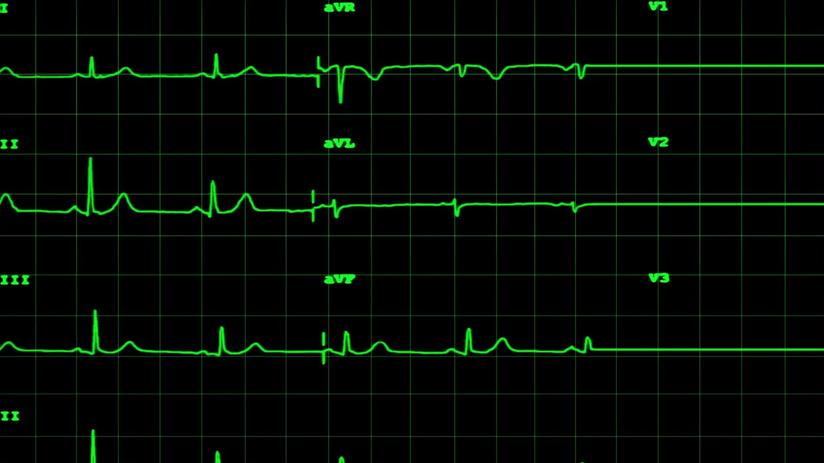
Future Scope
Expanding usage to rural health programs.
Where limited access to advanced healthcare facilities.
AI health analysis
Minimizes the need for expert interpretation.
Detecting abnormal heart rhythms (e.g., arrhythmias) automatically.
Remote Data broadcast
Enabling doctors to analyse ECG data remotely.
Notifications to healthcare providers during critical conditions.
Save and access historical ECG data anytime.
Improved Performance
Noise Reduction
Enhanced Signal Accuracy
Wireless Capability
Integrating LoRa for transmitting data long range without internet connectivity.
Elimination of wires in electrodes.

Slide 13
Conclusion
In conclusion, our project Single Lead ECG Machine provides a cost-effective and portable solution for basic heart monitoring. With its simplicity and effectiveness, it can be widely used in healthcare facilities and rural areas. This project underscores the importance of affordable technology in improving medical diagnostics.
Our project demonstrated:
The ability to capture, amplify, and filter ECG signals using low-power electronics. Processing of ECG signals to display and for analysis.
This project not only highlights the practical implementation of ECG systems but also opens opportunities for low-cost healthcare solutions.

Slide 14
Thank You…
Any Questions?

